Slide 1

Guidelines
Kindly use the given template for submitting your project.
One team is only required to submit one project.
The ideal size of the presentation should not be more than 10 slides.
You are welcome to add as many POCs and design concepts to support your project.
The project should be feasible and the team members should be capable enough, to come up with the prototype of the same idea, if required.
Projects mentioning the use Google developer technologies like Gemini APIs & building projects on IDX platform will earn additional points.
In case of queries, kindly reach out to us at solutionchallengesupport@hack2skill.com
Important Note: Registrations for the GDG on Campus Solutions Challenge are open until March 6th, and project submissions will be accepted until March 28th.
However, to be eligible for the exclusive India Bootcamps, please register and submit your project by February 16th.

Slide 2
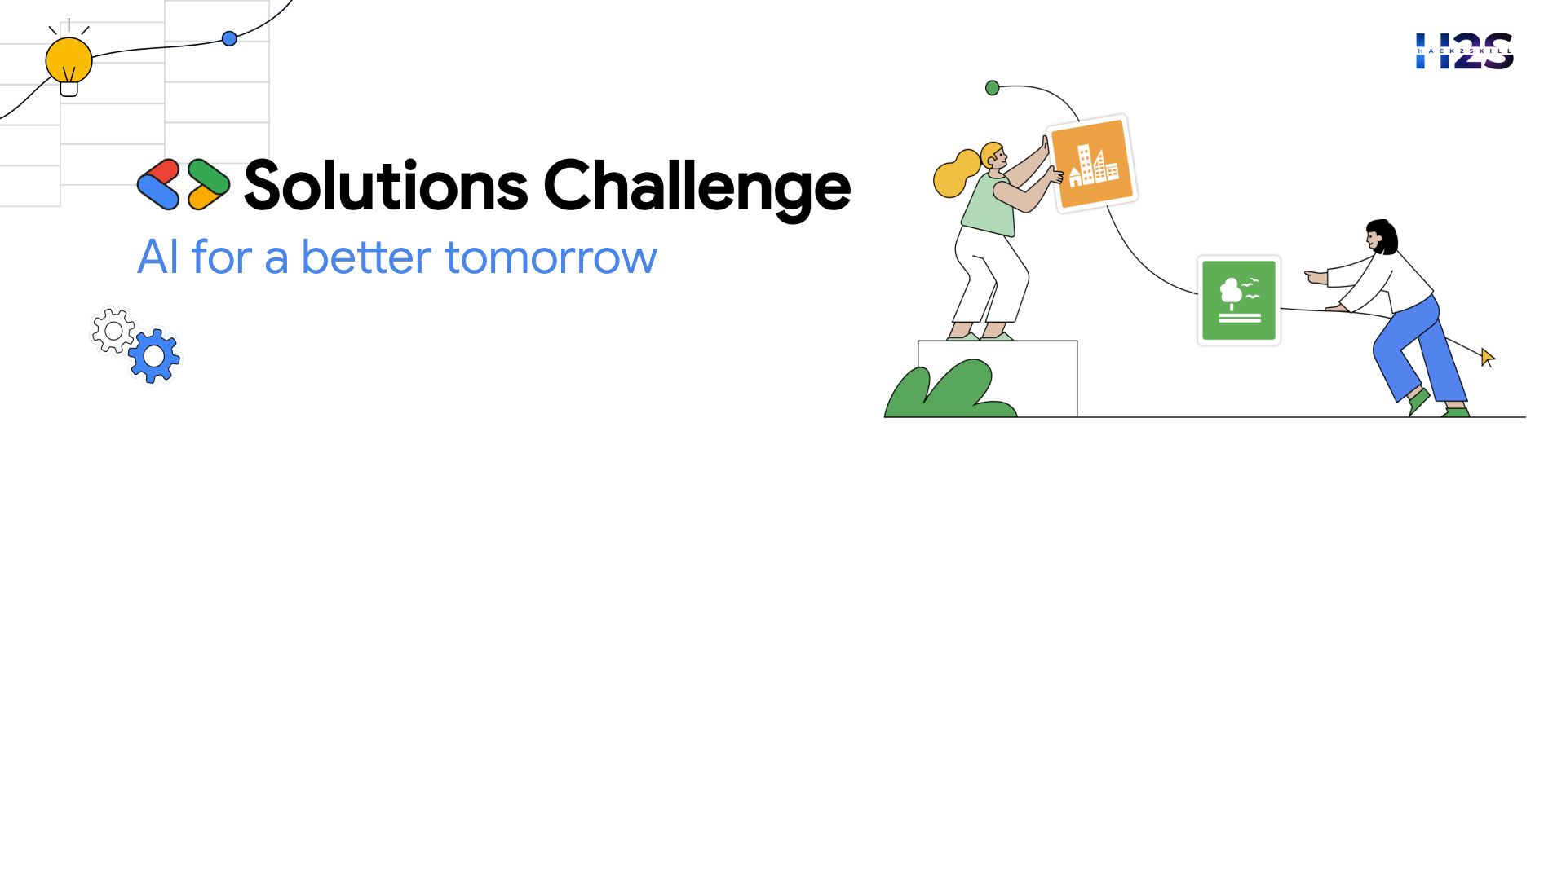
Idea Submission for Bootcamps
Team Details
Team name:
Team leader name:
Problem Statement:

Slide 3
Brief about the idea

Slide 4
Opportunities
How different is it from any of the other existing ideas?
How will it be able to solve the problem?
USP of the proposed solution

Slide 5
List of features offered by the solution

Slide 6
Process flow diagram or Use-case diagram

Slide 7
Wireframes/Mock diagrams of the proposed solution (optional)

Slide 8
Architecture diagram of the proposed solution

Slide 9
Technologies that are being used/planning use during prototype development
(Additional points for those who are:
Building their project on IDX
Integrating Gemini APIs)

Slide 10
Estimated implementation cost (optional)

Slide 11
Additional Details/Future Development (if any)

Slide 12
Provide links to your:
GitHub Public Repository

Slide 14
